Slide 1
UNSUPERVISED MACHINE LEARNING
“The World's Billionaires”
TING CHONG NA
28.05.2023

Slide 2
DATASET
Topic:
“The World's Billionaires”
Objective:
To determine if any patterns exist among the richest people in the world.
Rumor has it that the ultra-wealthy community consists of either investment bankers or entrepreneurs in the tech industry that dropped out of college. Is that stereotype really true? Ever wonder if the top billionaires in the world share anything in common?
Dataset:
"The World's Billionaires" is an annual ranking documenting the net worth of the wealthiest billionaires in the world, compiled and published in March, annually, by the American business magazine - Forbes.
Dataset containing the list of 2500+ people with fortunes valued at least 1 Billion USD.

Slide 3
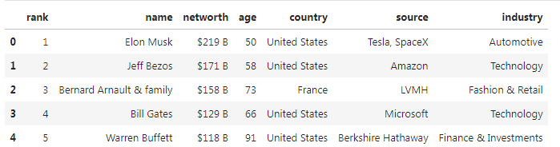
DATASET
2600 observations
7
features
The features available from the dataset are:
Rank
Name
Net Worth - their net worth in billions USD
Age
Country
Source - their source of income
Industry - sector/industry/market segment in which each billionaire has made their fortune

Slide 4
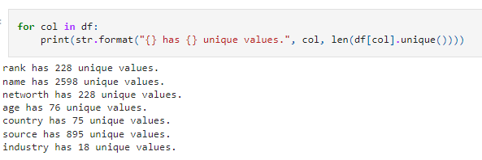
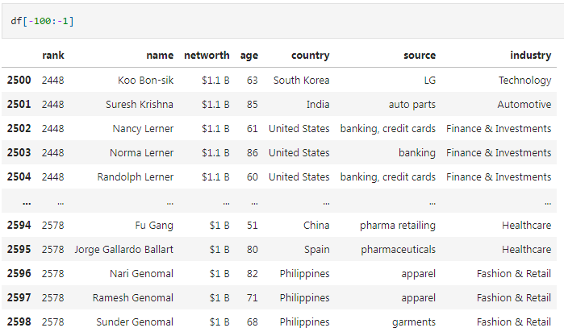
DATA ANALYSIS
228 unique rank values
due to many ties in the rankings
2298 unique name values
895 unique source values
possibly won't help with rank prediction
can be excluded

Slide 5
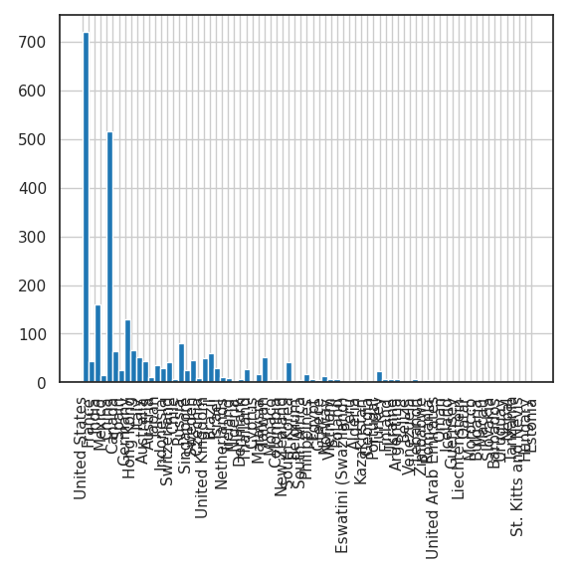
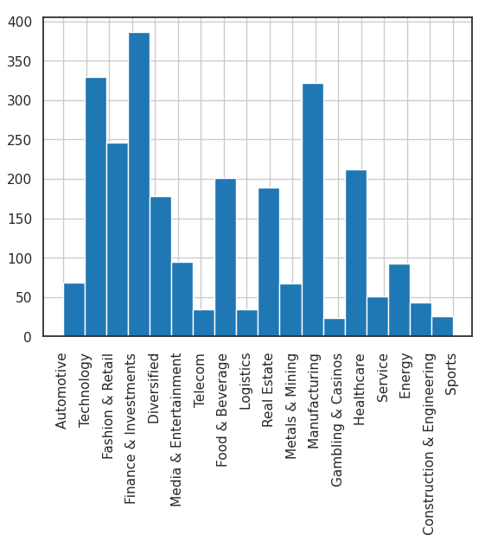
DATA ANALYSIS
For Categorical variables
Certain countries contain more billionaires than others
United State (27.6%)
Certain industries contain more billionaires than others
Finance & Investments (14.8%)
China (19.8%)
India (6.2%)
Technology (12.6%)
Manufacturing (12.3%)
Histogram for country
Histogram for industry

Slide 6
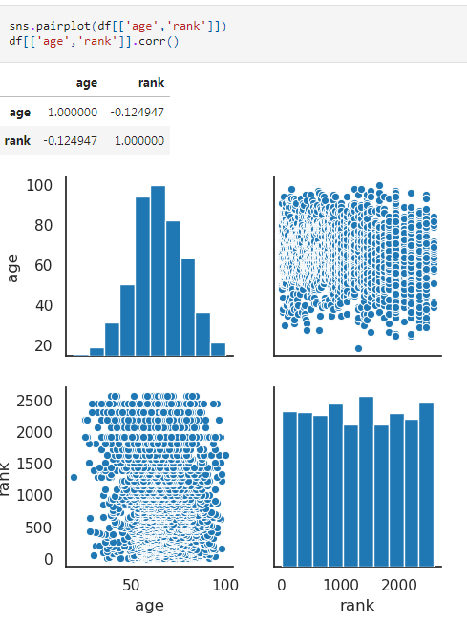
DATA ANALYSIS
For Numerical variables
2 features age and rank
are Negatively Correlated
Correlation coefficient (age and rank)
Pairwise plot (age and rank)

Slide 7
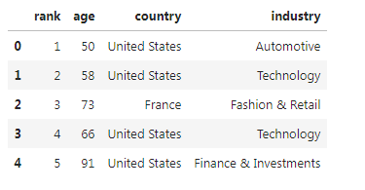
DATA ANALYSIS
y=df['rank']
df.drop(columns=['name','networth','source'],inplace=True)
For prediction
drop all the features not going to use
7 features
4 features

Slide 8
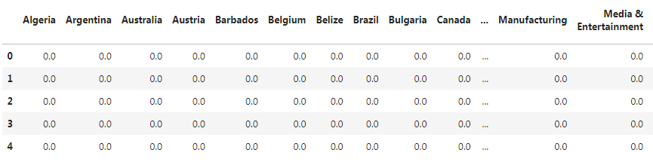
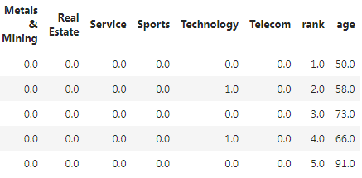
DATA ANALYSIS
For Categorical variables
Categorical variables country and industry are not ordinal, meaning that the categories don't have a specific order.
Apply One-Hot Encoding to convert their levels into dummy variables.
Before
One-Hot Encoding
After
One-Hot Encoding

Slide 9
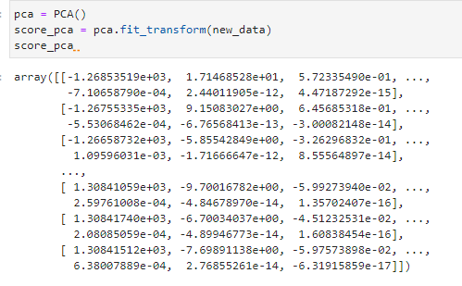
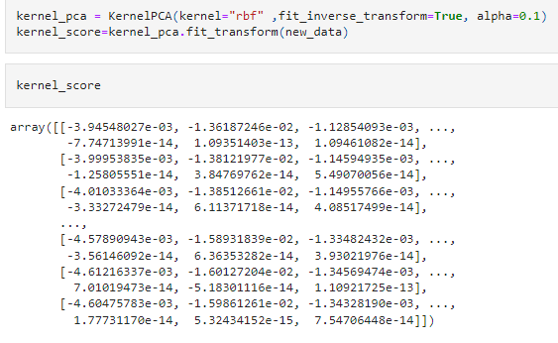
Model: PCA vs KernelPCA
PCA
KernelPCA

Slide 10
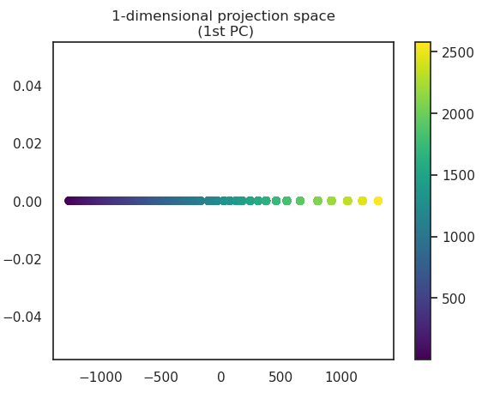
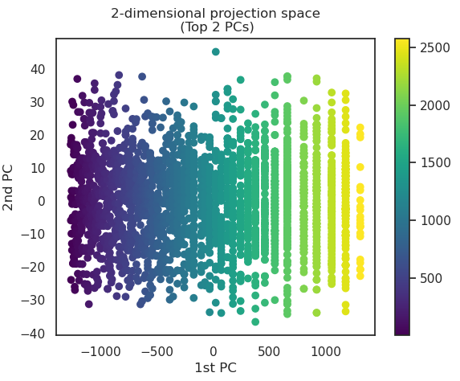
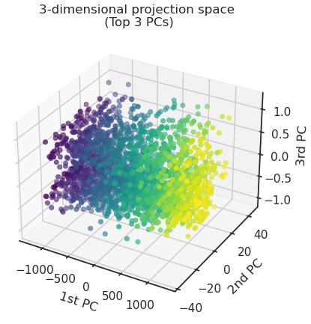
Model: PCA
PCA
Apply PCA and plot the projection space in 1, 2, and 3 dimensions respectively.
In the 2-dimensional and 3-dimensional projection space, we see a similar trend that rankings change across the x-axis, meaning that most of its variation occurs in the projection on the first principal component.

Slide 11
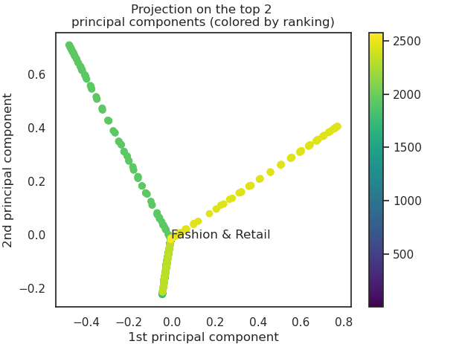
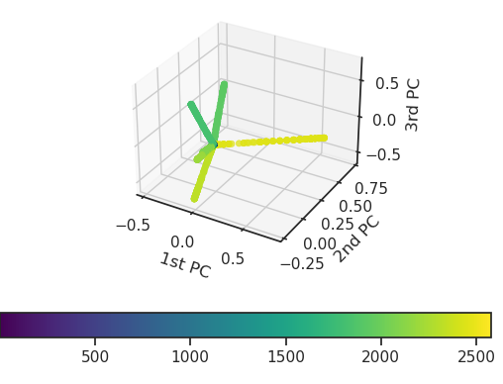
Model: KernelPCA
KernelPCA
A Bifurcation of the data dependent on the rank.
The diverging branches suggest that difference in ranking can be associated with certain patterns in the data.
This becomes more apparent in the 3-dimensional projection space.
Each line corresponds to a different range of ranking (represented by the varying colors).

Slide 12
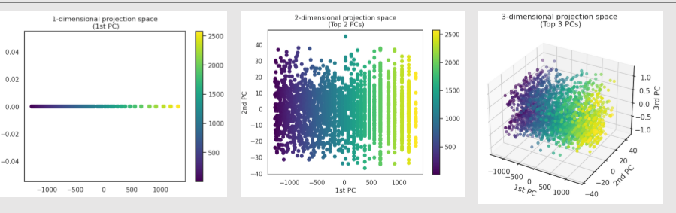
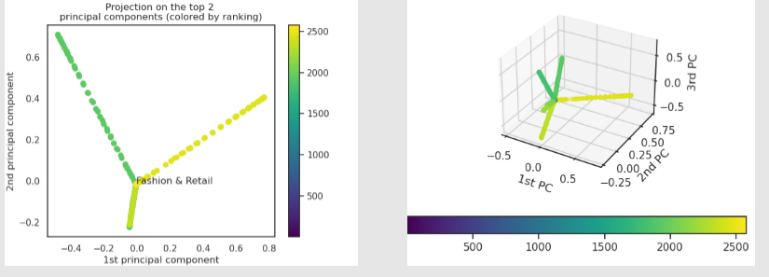
Model: PCA vs KernelPCA
PCA
KernelPCA
From this example, we can observe that surely, some combination of the features country, industry and age leads to consistent change in rankings.
It is important to note that due to the nature of PCA in general, unable to decrypt what that combination is.
Difference in ranking can be associated with certain patterns in the data.
KernelPCA will improve Visualization, compare to PCA.

Slide 13
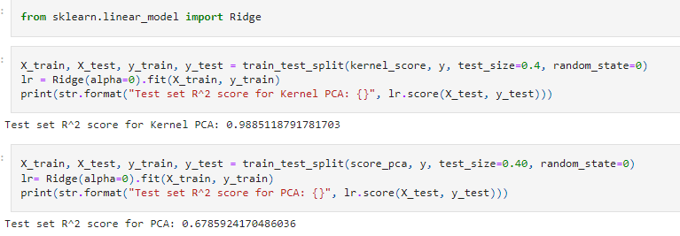
Model: PCA vs KernelPCA
Add Ridge.
KernelPCA
R^2: 0.989
PCA
R^2: 0.679
Kernel PCA generally performs better given a higher R^2 (coefficient of determination) score on the test set, compare to PCA.
KernelPCA will improve Prediction, compare to PCA.

Slide 14
CONCLUSION
In conclusion, KernelPCA seems to be the best method to determine if any patterns exist among the richest people in the world.
Improve Visualization
Improve Prediction

Slide 15
POSSIBLE FLAW IN MODEL
Computational Cost
Inverse Mapping
PCA generally has lower memory and runtime requirements than KernelPCA, and can be scaled to massive datasets
Unlike PCA, KernelPCA may not give perfect reconstruction
KernelPCA spans a subspace of the original data, so applying inverse transformation on the data after KernelPCA will not return the original data.

